Slide 1


EEC 136AB: Team Charlie
Aakansha Bhatt, Anshu Paudyal, Ingmar Diaz, Michael Foster, Raunaq Chopra, Yang Ye
March 19th 2021

Slide 2
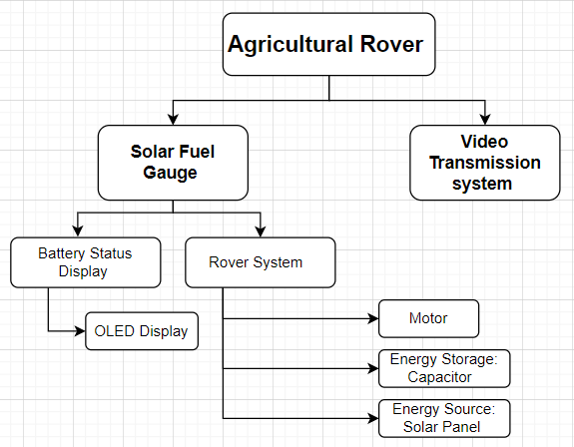
Overview

Slide 3
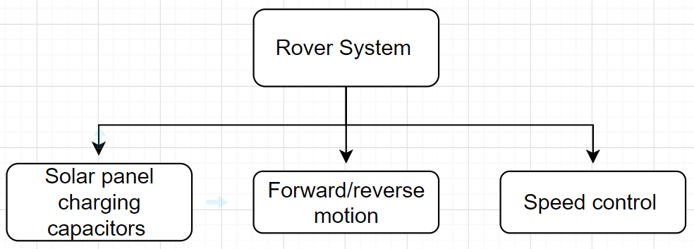
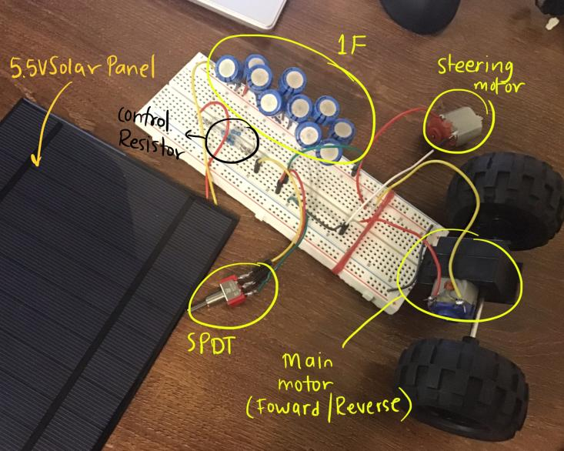
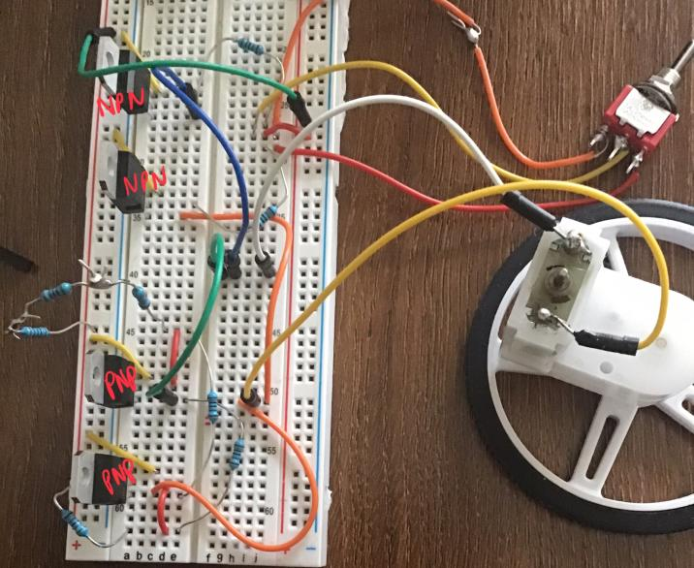
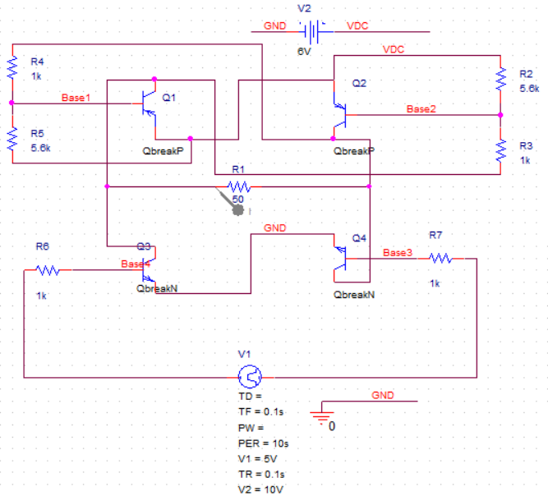
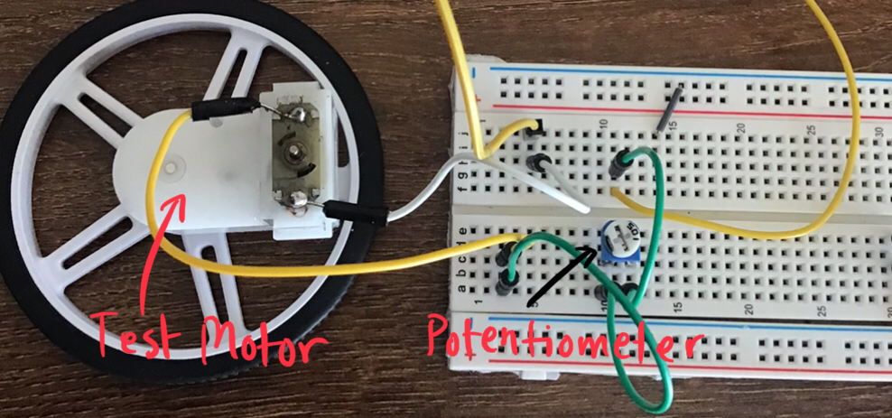
Hardware: Rover System

Slide 4
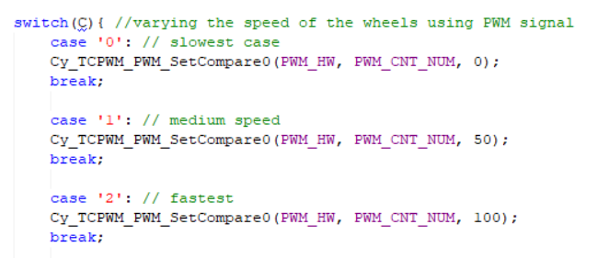
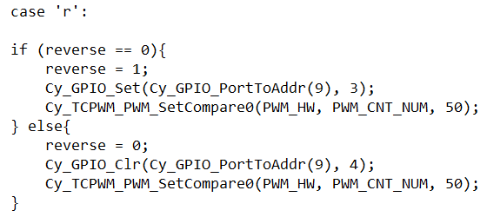
Firmware: Rover System
Direction control - forward and reverse directions through PWM signal
Speed control - slow, medium and fast speed through PWM signal

Slide 5
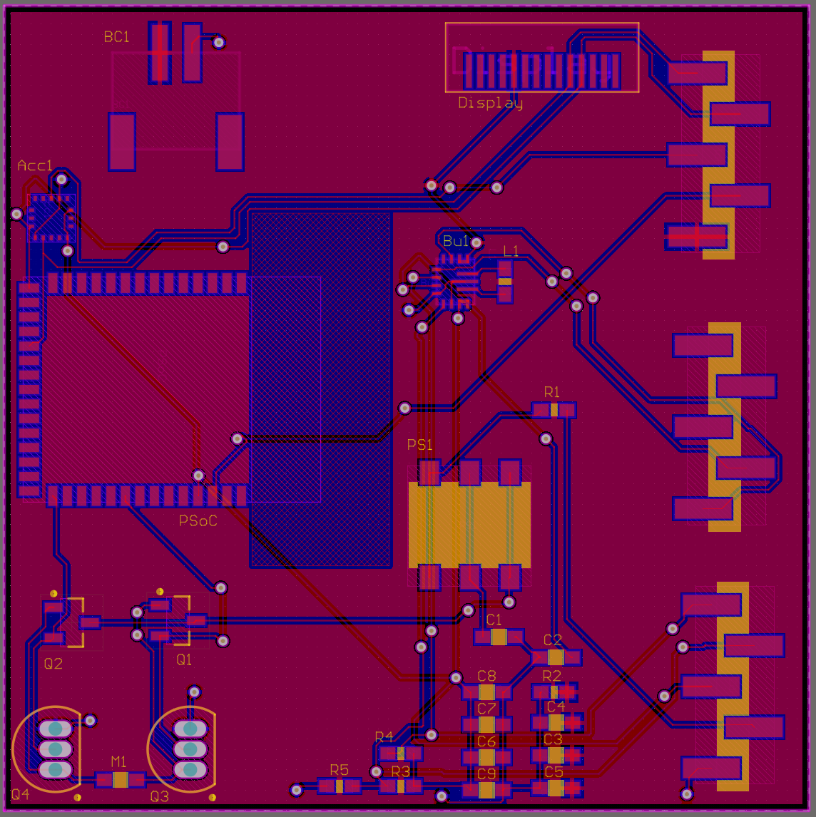
Hardware: Altium Design
Changes from Alpha Prototype:
Board dimensions adjusted based on free space on chassis. Board is now 50x50 mm in dimensions
All off-board component connections, for example the motor, battery connector and header pins, have been moved to the edge of the board
Proposed changes for future:
A voltage divider around the H-bridge to better regulate the voltage across the BJTs
An IC H-bridge instead of a discrete component bridge

Slide 6
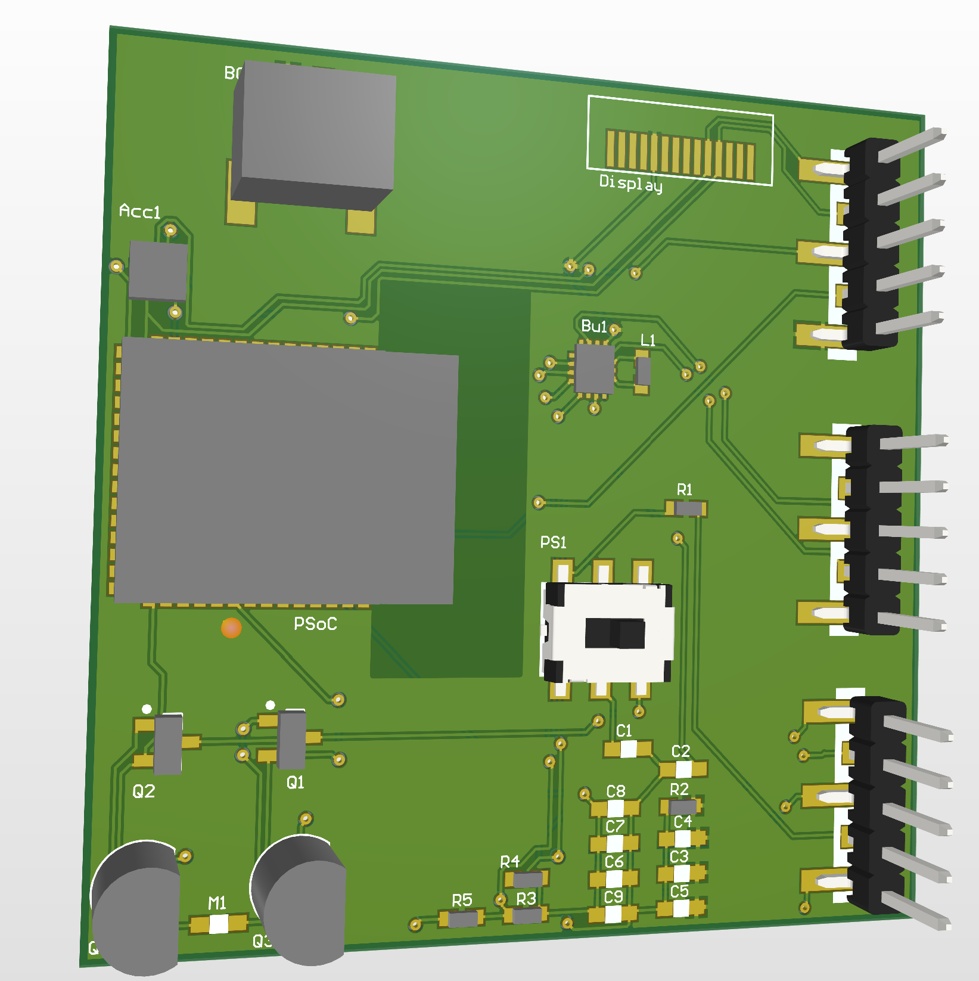
Hardware: Altium Design

Slide 7
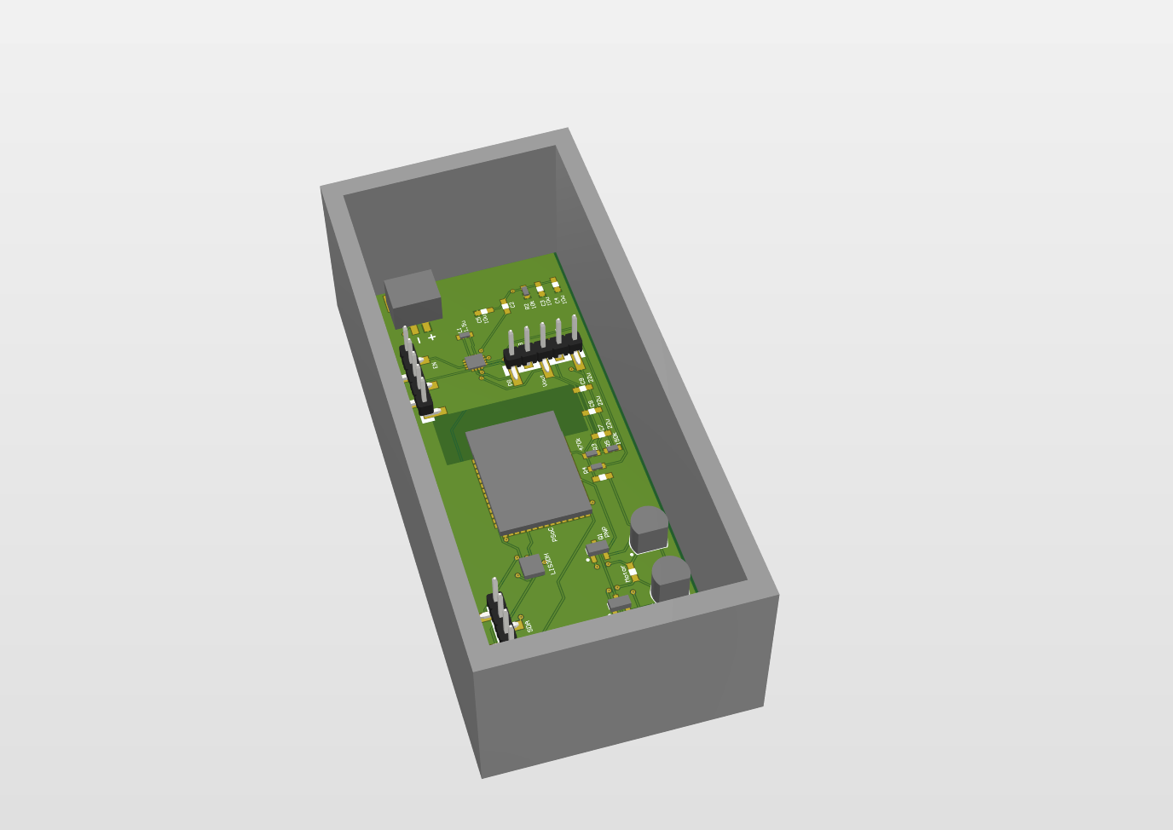
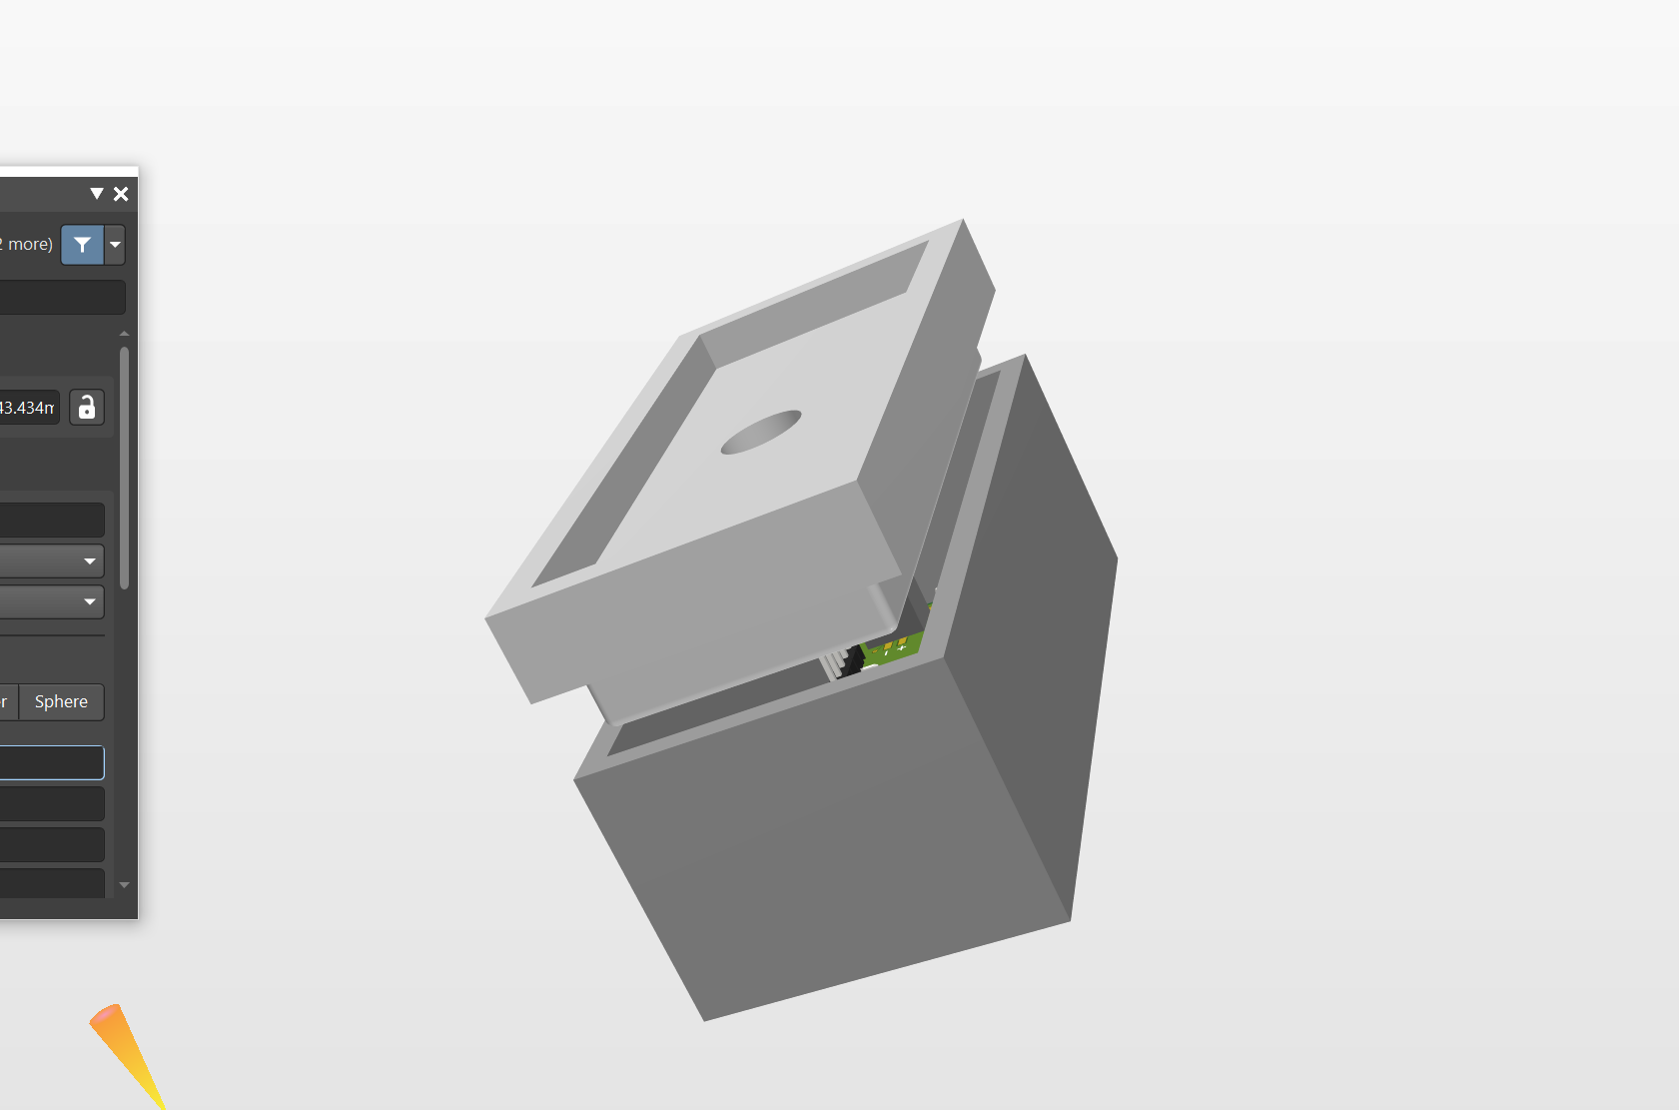
3D Enclosure
3D enclosure

Slide 8
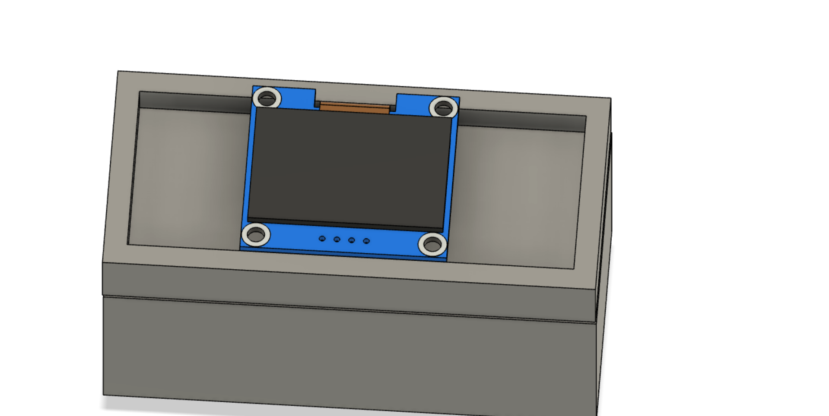
3D Enclosure
3D enclosure

Slide 9
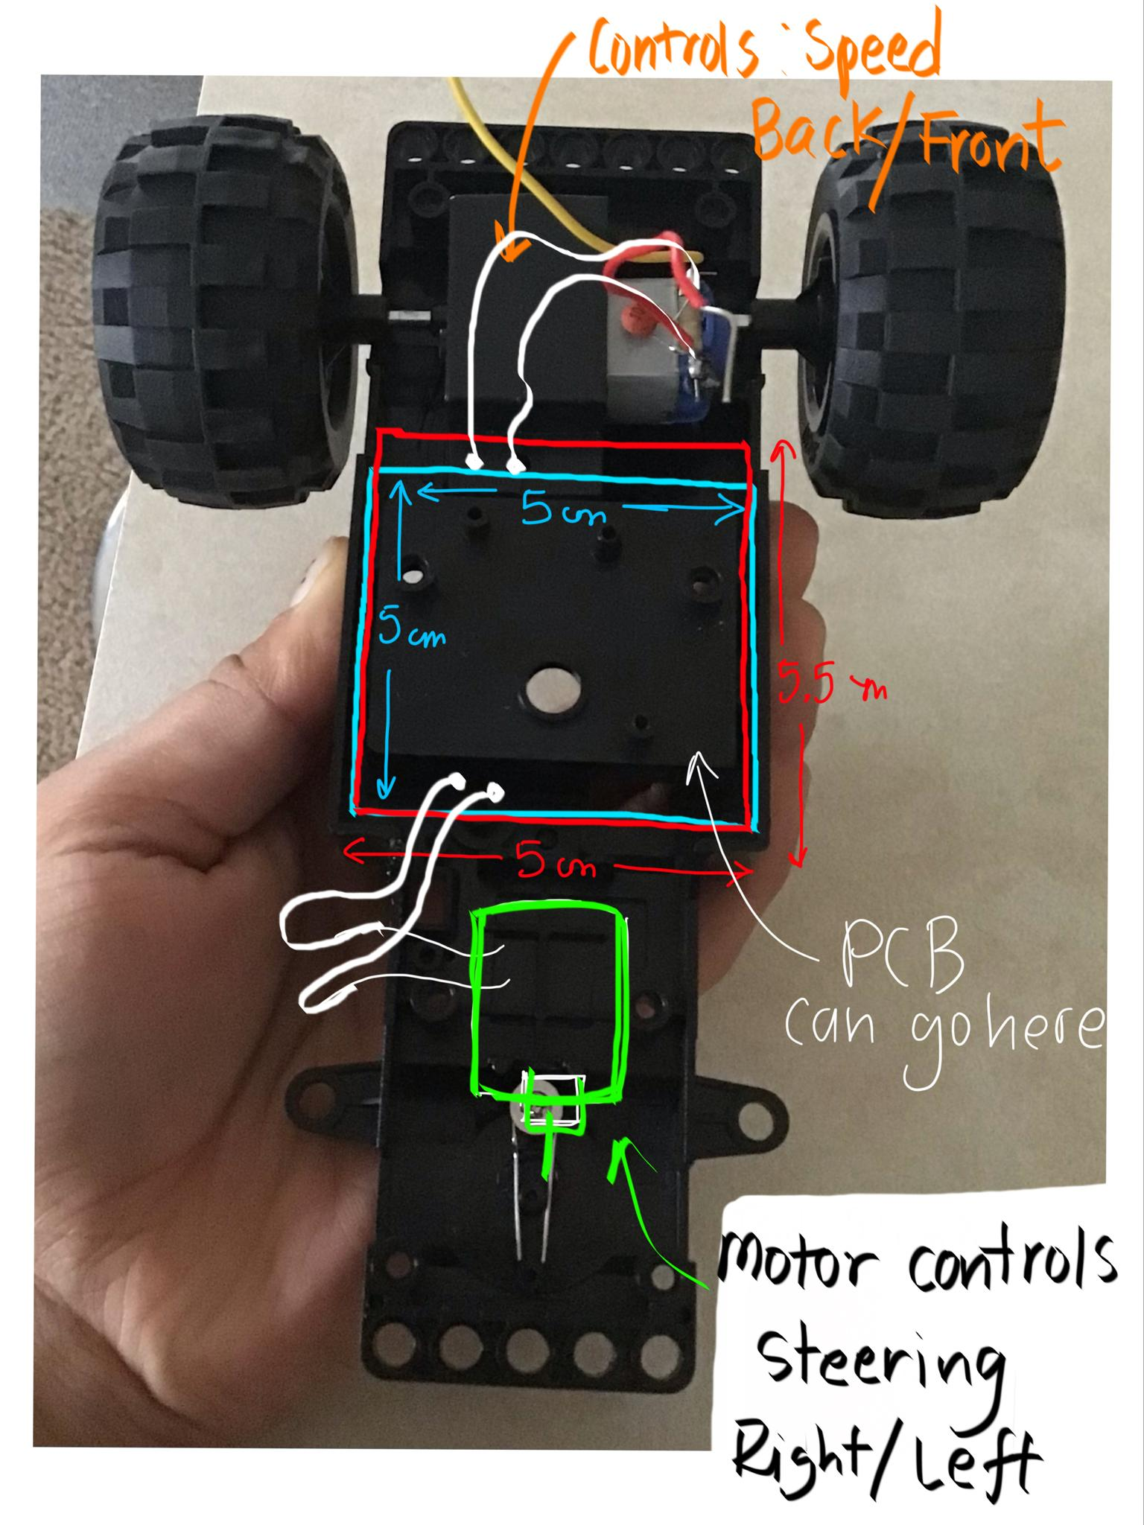
Mechanical

Slide 10
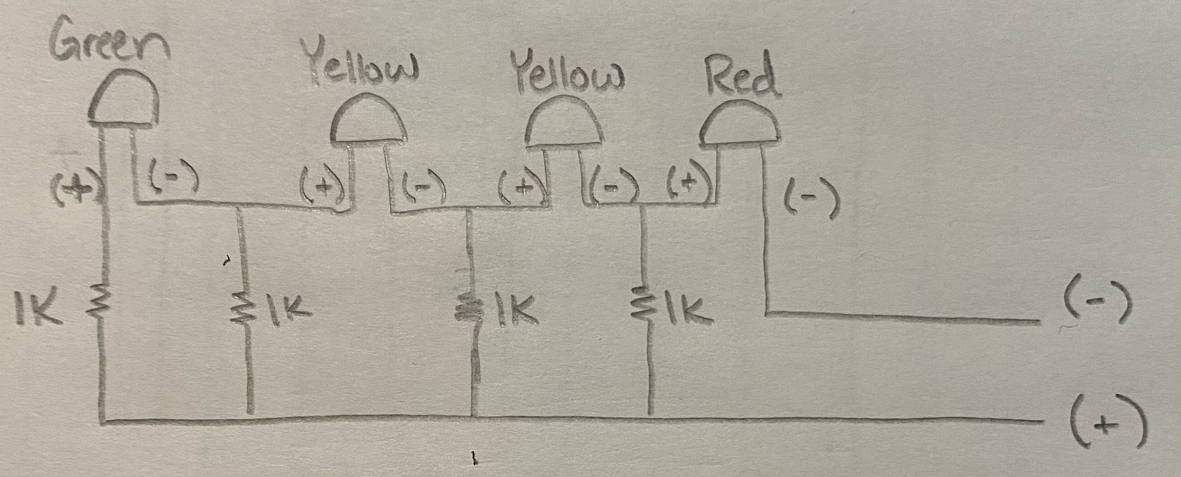
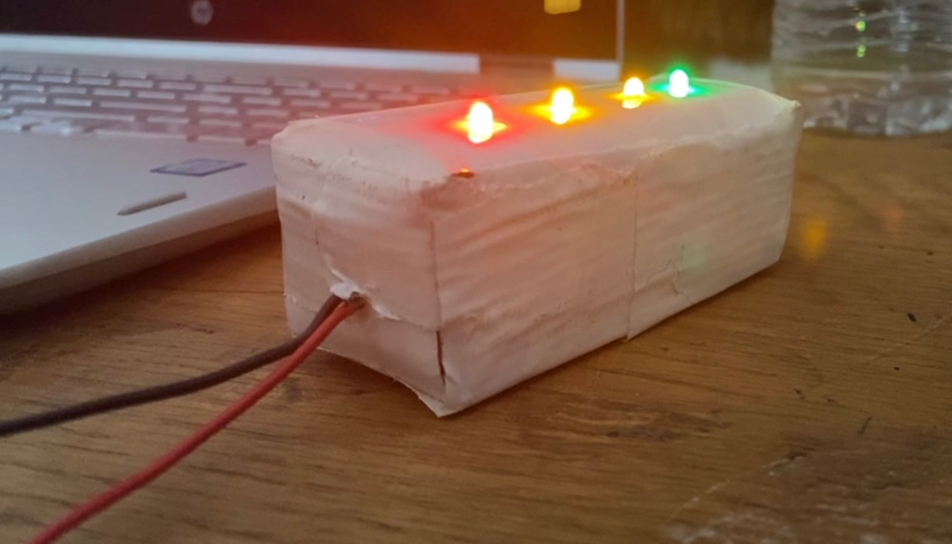
Hardware: Interactive Lights
-Red LED ~ 0-1V
-Yellow LEDs ~ 1-3V
-Green LED ~ 3-4V
Due to this design having a large amount of Voltage consumption from our power system, this design was omitted and is now just a light feature for the rover.

Slide 11
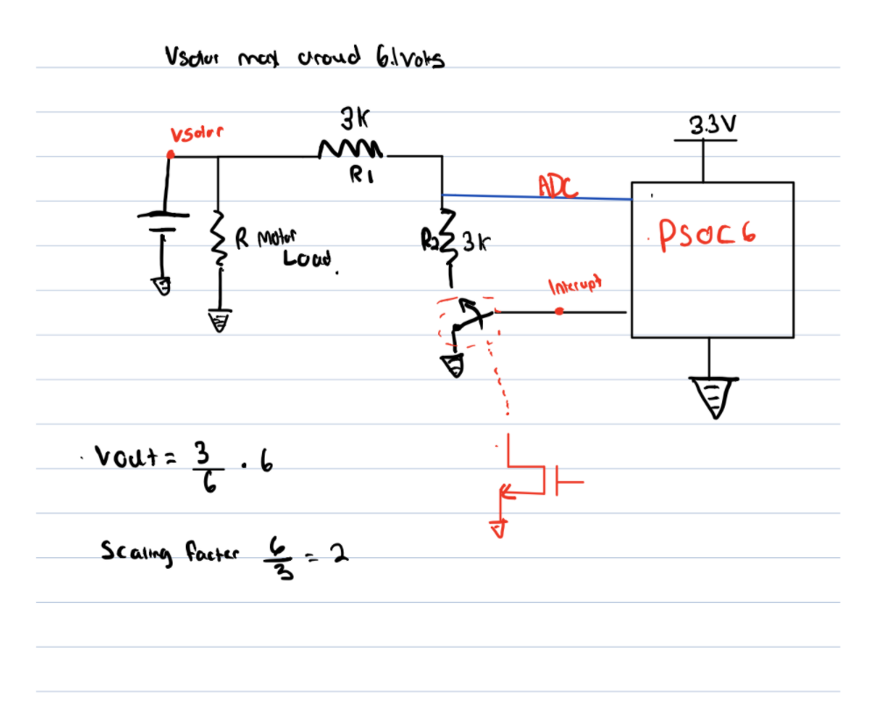
Hardware: OLED Solar fuel gauge
Analog circuit schematic of solar fuel gauge

Slide 12
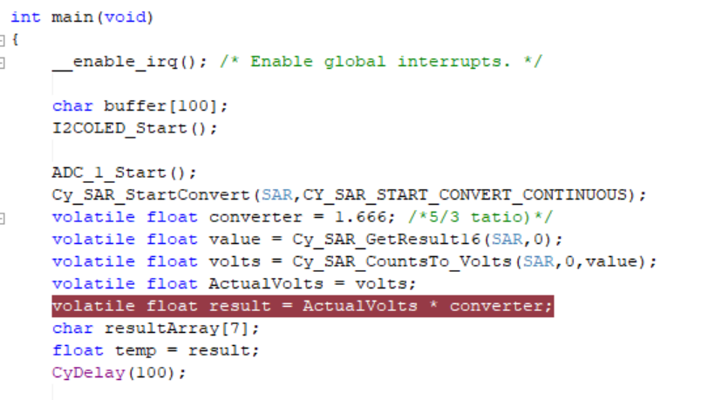
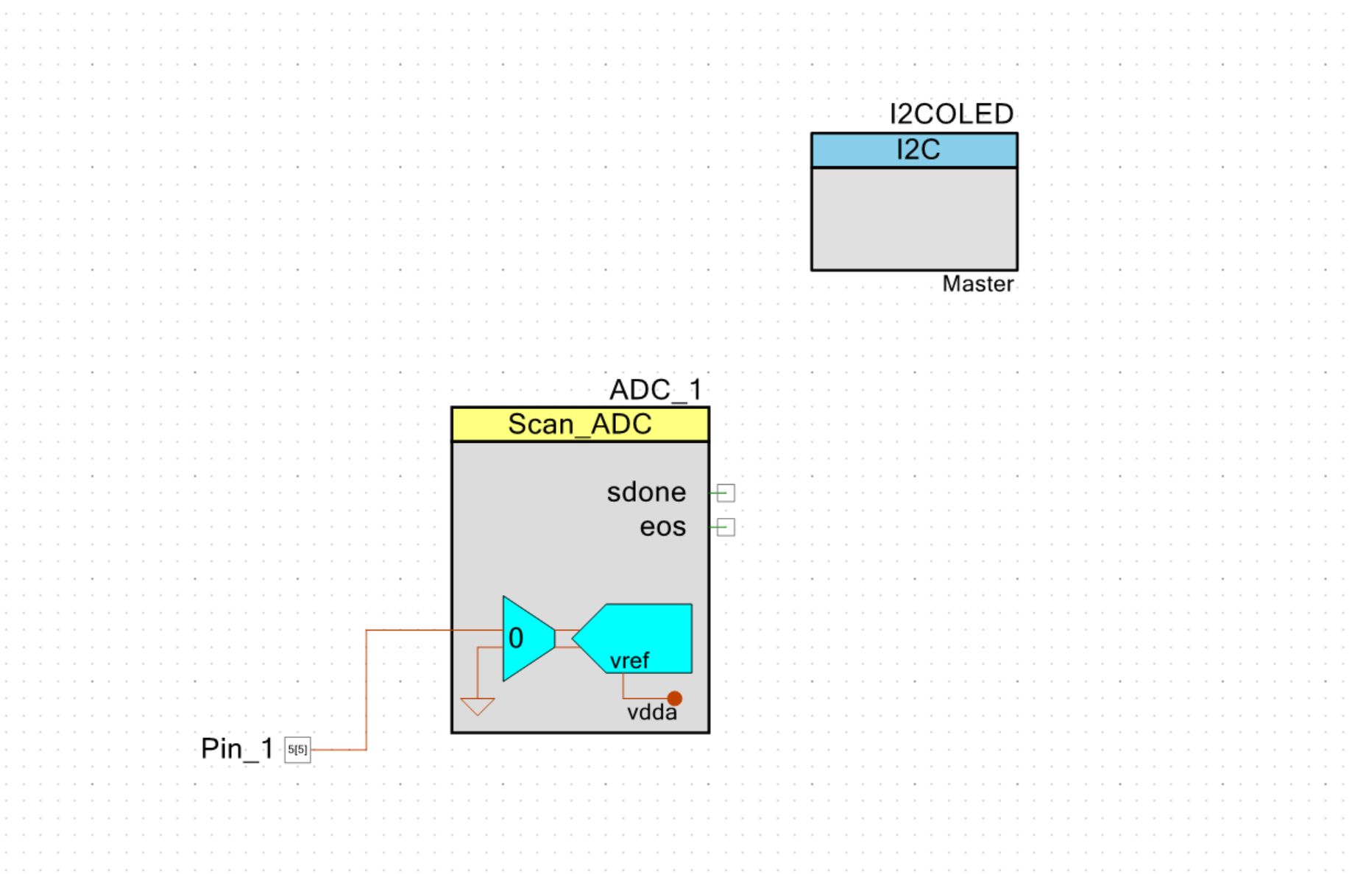
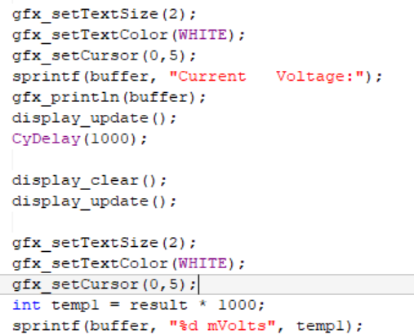
Firmware: OLED Top Design & Code

Slide 13
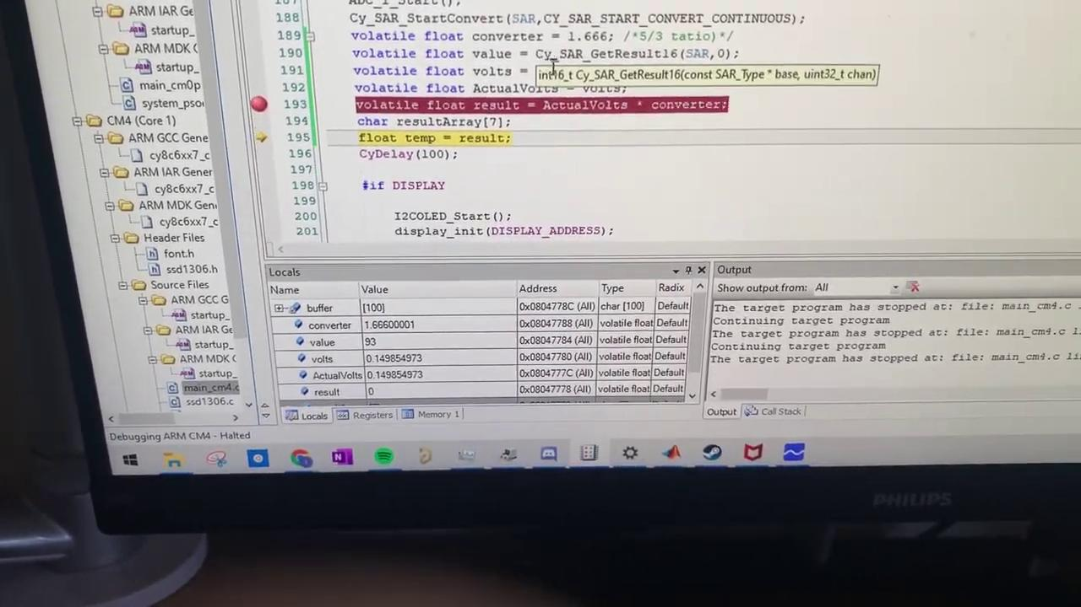
OLED

Slide 14
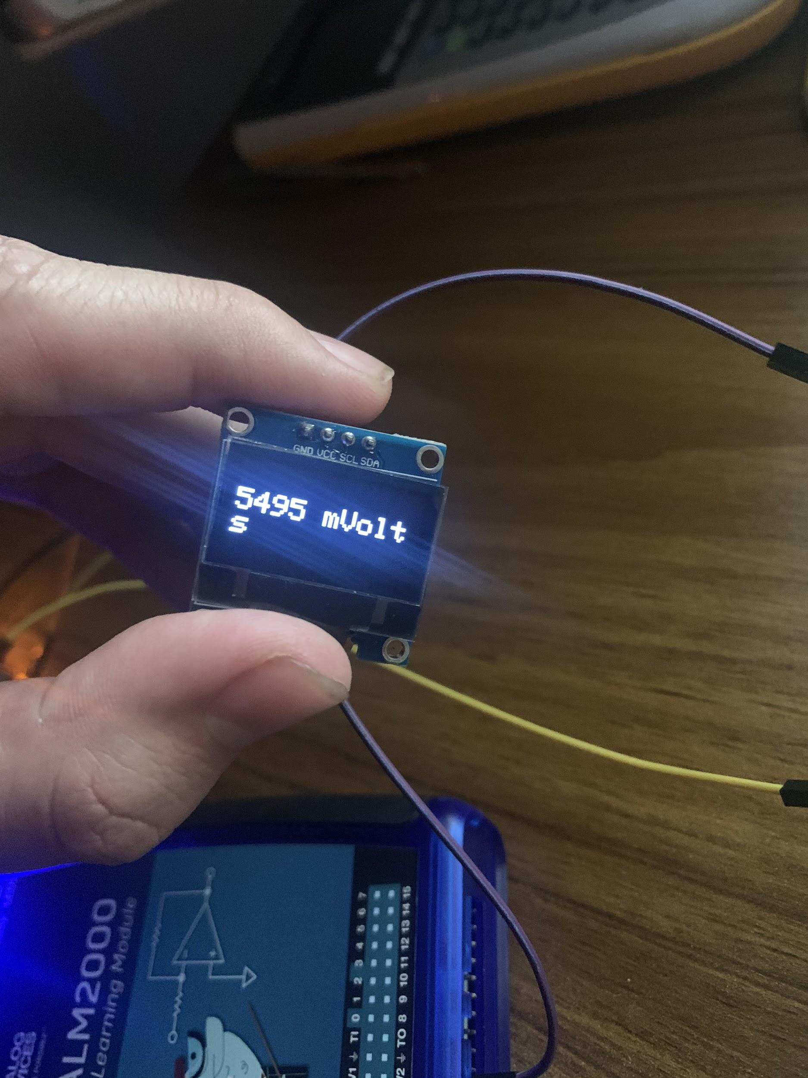
OlED Display
Future Implementations
Adding switch to solar fuel gauge
Temperature and Humidity Sensing Display

Slide 15
Power Analysis
 | Capacity | Voltage | Power or Energy
OLED | 20mAh | 1.6-3.3V | 66mW
Solar Panel | 500mAh | 5V | 2.5W
Capacitors | 2.75mAh | 5.5V | 15.1mW
Rechargeable Battery | 400mAh | 3.7V | 1.48kJ
PSOC6 | 20mAh | 1.7-3.6V | 72mW
Notes:
Description of the total power our system is using.

Slide 16
Project budget & Bill of Materials
Item | Unit cost ($) | Amount | Shipping ($) | Cost (tax+shipping) ($)
H-bridge | 4.45 | 2 | 5.72 | 14.62
0.1F Capacitors | 1.3 | 10 | 13.39 | 26.39
Rover | 41.79 | 1 | 0 | 41.79
Solar Panel | 12.99 | 3 | 0 | 38.97
Mosfet | 15.49 | 1 | 0 | 15.49
Capacitors | 18.39 | 1 | 0 | 18.39
Toggle Switch | 4.14 | 2 | 0 | 8.28
OLED display | 7 | 3 | 0 | 21
total |  |  |  | 184.93

